Slide 1

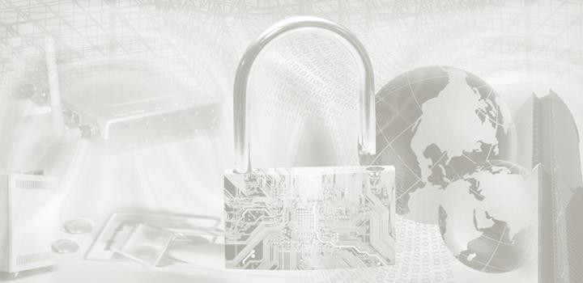
ITEC614 Introduction to Cyber Security
Dr. Farshid Keivanian
Lecturer, Information Technology, PFBS

Slide 2
Secure Hash Algorithm and Digital Signature
Lecture 6

Slide 3
Previous Lecture
We have studied ….
Trusted computing
Security management processes
Risk assessments
Risk treatment
STRIDE
DREAD

Slide 4
Outline
Hash function
Properties of hash function
Attacks on Hash
SHA-2
SHA-3
Digital signature
ElGamal signature
DSS

Slide 5
Reference
This lecture is based on
Cryptography and Network Security: Principles and Practices, 7th Ed, William
Stallings, 2017
Chapter 11 & 13
and supplementary materials

Slide 6
What is a Hash Function?
A hash function turns any message (short or long) into a fixed-size code called a message digest.
It’s one-way only – you can’t reverse it to get the original message.

Slide 7
What is a Hash Function?
A hash function turns any message into a short, fixed-length “digital fingerprint”.
Easy terms:
“This is a test.” → becomes → d5579c46...
One-way: you can’t reverse it back to the message
Common in Australia for login systems and file checksums

Slide 8
What is a Hash Function?
Use cases:
Password protection
File integrity check (e.g., verifying downloaded COVID check-in app)
Digital signatures
Example in Australia: MyGov passwords are stored using hash functions.

Slide 9
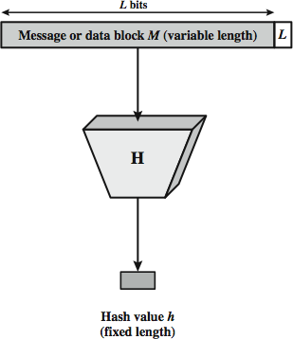
How Hashing Works
Step | Description
1 | Input a message (text, file, etc.)
2 | Apply a hash algorithm like SHA-256
3 | Output: a short fixed-size hash (e.g., 64 characters)
 | Even a small change (like a full stop vs ! ) = totally different hash
This makes it perfect for detecting changes or tampering.

Slide 10
Why Hash Collisions Matter
A collision is when two different messages create the same hash (BAD!).
MD5 had this issue in 1996 → not used anymore.
SHA-256 is stronger and safer (used by banks and government).
Example: Banks like NAB use SHA-256 in secure communications.

Slide 11
Hashing + Security
Hashing is used in:
Password storage (with salt for extra protection)
File integrity (e.g., NDIS.gov.au downloads)
Digital signatures (see next!)

Slide 12
What is a Digital Signature?
Concept | Description
Integrity | Message not altered
Authentication | Sender is genuine
Non-repudiation | Sender can’t deny they sent it

Slide 13
What is a Digital Signature?
Alice signs a message with her private key
Bob checks it using her public key
Used in contracts, e-signing, and secure messaging

Slide 14
Example – Hash + Digital Signature
Purpose: To ensure data hasn’t been changed and prove who sent it.
Example:
Alice at ACU signs an offer letter for Bob
She hashes it and encrypts the hash with her private key
Bob uses her public key to check if the letter is real

Slide 15
Example – Hash + Digital Signature
Ensures:
Integrity (not modified)
Authentication (really from Alice)
Non-repudiation (Alice can’t deny it later)

Slide 16
Hash Function Properties
Important Features:
Works on any size message
Output is always same length
Easy to compute, hard to reverse
Two different messages → should never create the same hash

Slide 17
Hash Function Properties
Australian Context:
Used in government portals for secure uploads

Slide 18
Requirements for Hash Functions
Property | What It Means | Why It Matters
One-way | Can’t go backward from hash to message | Password safety
Collision-resistant | No two inputs give same hash | Prevent fake digital files
Fast to compute | Efficient for devices | Apps, banking, login systems

Slide 19
Requirements for Hash Functions
Example:
Australia Tax Office (ATO) uses strong hashing for online submissions

Slide 20
Research / Discussion Questions
Why are hash functions considered one-way?
They’re designed so you can't go backward from the hash to the original input.
2. Why is a collision dangerous?
It could let a hacker fake documents with the same hash.

Slide 21
Research / Discussion Questions
What makes SHA-256 better than MD5?
SHA-256 has no known collision issues, while MD5 is broken.
Why is hashing important in Australian banking apps?
To protect passwords and verify transactions securely.
Is it possible to reverse a hash? Why or why not?
No. That’s the one-way property — hashes don’t store input info

Slide 22
Hands-On Activity
Task: Try hashing a short message using SHA-256 Tools: CyberChef
Steps:
Type: This is a test. → SHA-256
Now change to: This is a test!
Compare the hash outputs – are they totally different?

Slide 23
Hands-On Activity
In the "Input" box, we type our message (you've already written This is a test.).
In the left panel, we search for SHA-256.
Double Click on SHA2

Slide 24
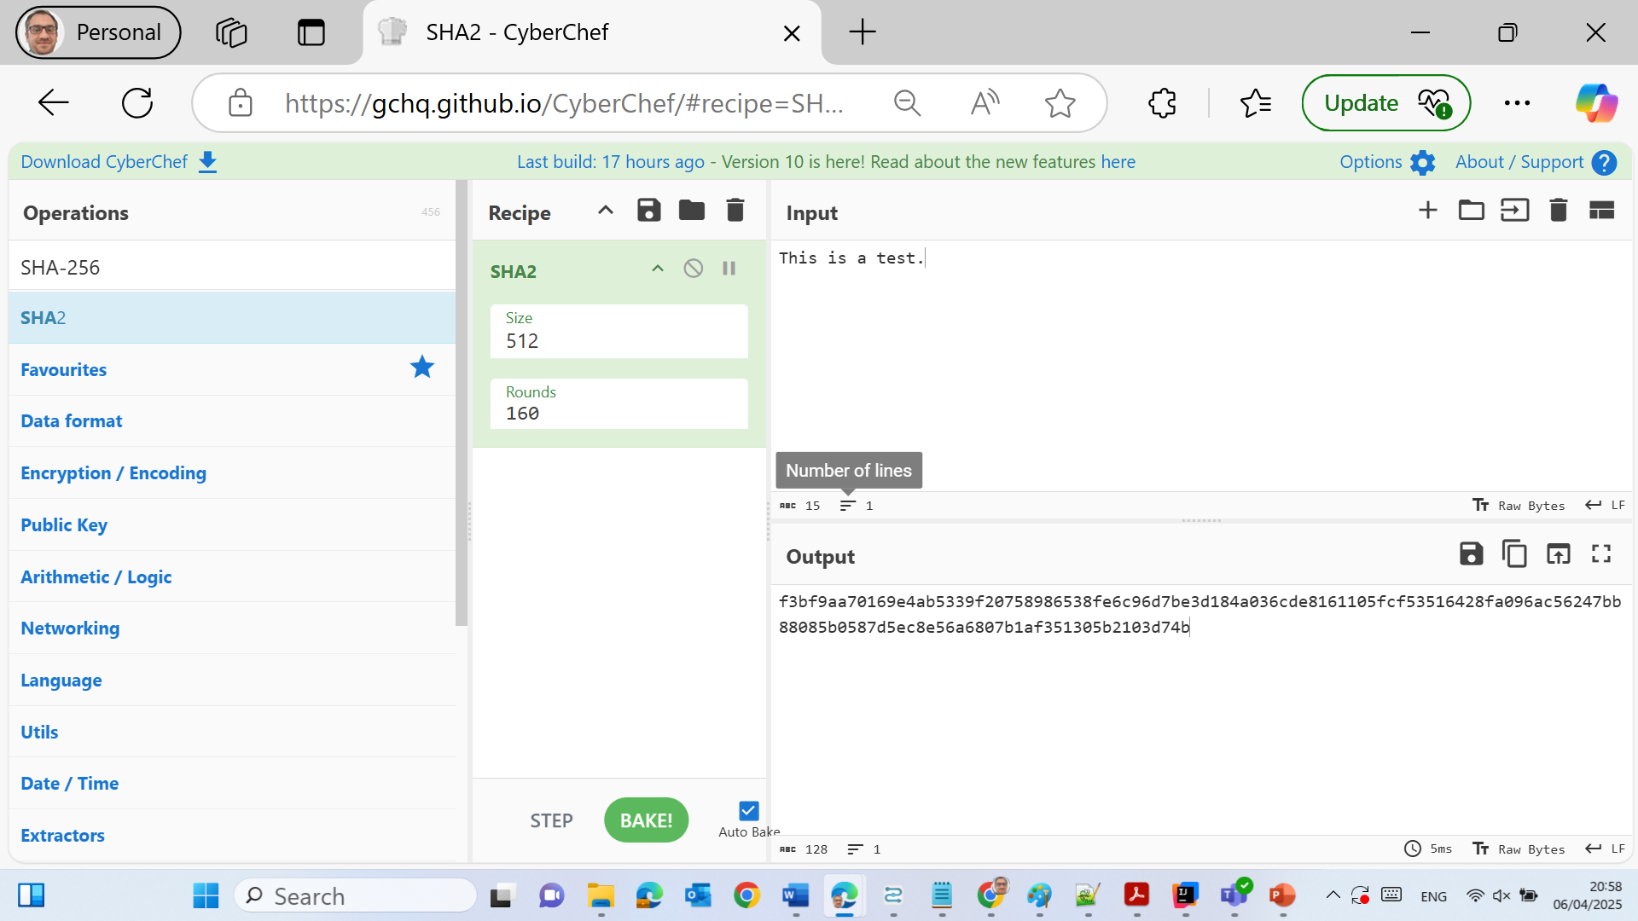
Hands-On Activity

Slide 25
Hands-On Activity
The Output section will now show the hash value (a long string of 64 hex characters).

Slide 26
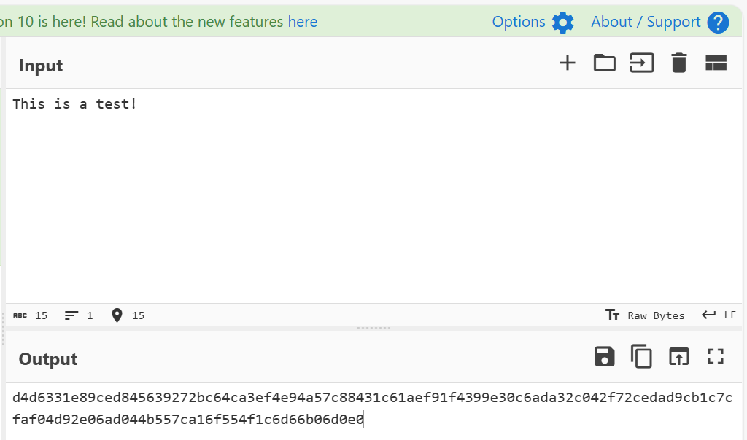
Hands-On Activity
We can also try changing one small part of our message (e.g., the period . to !) and see how different the hash becomes.

Slide 27
Cybersecurity Case Study (Challenge)
Problem: A university student submits a digital signature proving their assignment was theirs. Another student claims it’s fake.
Task:
How can the lecturer verify authenticity?

Slide 28
Cybersecurity Case Study (Challenge)
Use the student’s public key to decrypt the digital signature and verify it matches the hash of the assignment file.

Slide 29
Simple Examples of Hashing
Basic methods like XORing bits are early forms of hash functions.
Parity checks help detect simple errors, but not secure enough for today’s cybersecurity needs.
Example (Australia context): A MyGov form checksum might use a simple hash to verify data wasn't corrupted during transmission

Slide 30
Simple Examples of Hashing
Final hash = XOR(all bits) ⟶ simple, not secure

Slide 31
Attacks on Hash – Preimage Attack (Intro)
Preimage attack = finding input y that creates a given hash value.
Used by attackers to fake input matching a stored hash.
Example: An attacker wants to find a password that gives the same hash stored in a Centrelink database.
Challenge: “How hard is it to reverse a hash?”

Slide 32
Preimage Attack – Effort Analysis
If hash length is m bits, brute force needs 2^m tries to succeed.
More bits = stronger hash.
Australian analogy: Trying every Medicare number to match a hash. A 128-bit hash = 2^128 attempts… impossible in practice!

Slide 33
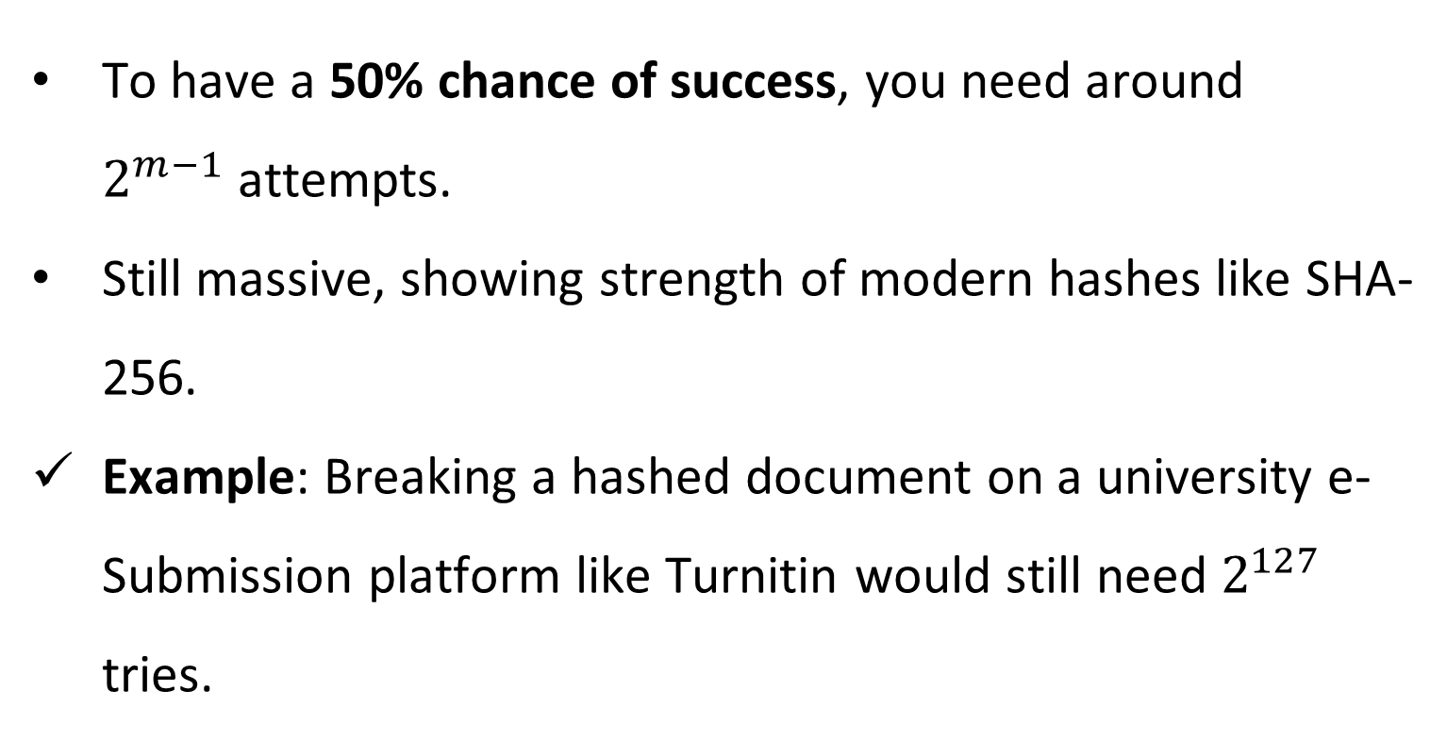
Preimage Attack – 50% Success Rate
To have a 50% chance of success, you need around $2^{m−1}$ attempts.
Still massive, showing strength of modern hashes like SHA-256.
Example: Breaking a hashed document on a university e-Submission platform like Turnitin would still need $2^{127}$ tries.

Slide 34
Summary Comparison Table – Hashing Strength
Hash Feature | Simple XOR | SHA-1 | SHA-256 (Recommended)
Output Size | 1 bit | 160 bits | 256 bits
Security | Weak | Obsolete | Strong
Used in Australia? | No | No (deprecated) | Yes (e.g., in Gov CMS)

Slide 35
Summary Comparison Table – Hashing Strength
Hash Feature | Simple XOR | SHA-1 | SHA-256 (Recommended)
Collision Resistance | Poor | Weak | High
Effort to Break | Easy | Moderate | Nearly impossible

Slide 36
Research/Discussion Questions
Why is SHA-256 preferred over older hash functions like MD5 or SHA-1?
Because SHA-256 avoids known collisions and is secure for modern digital signatures and password hashing.
2. Can a hash function be used for encryption? Why or why not?
No, hash is one-way only—it cannot decrypt or reverse.

Slide 37
Research/Discussion Questions
What happens if two people in different states submit forms that result in the same hash?
That would be a collision, which modern hashes are designed to prevent.

Slide 38
Hands-On Activity
Go to https://gchq.github.io/CyberChef/
Use an Input File (e.g., this one)
Apply: SHA-256 from Operations
See results

Slide 39
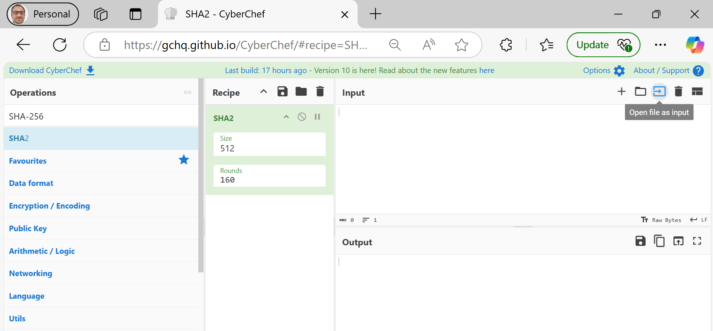
Hands-On Activity

Slide 40
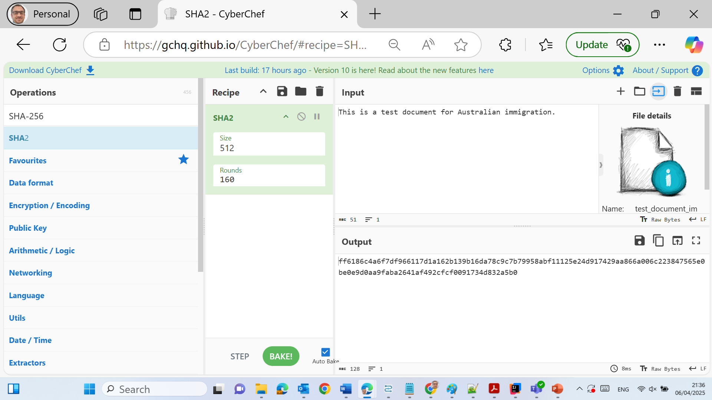
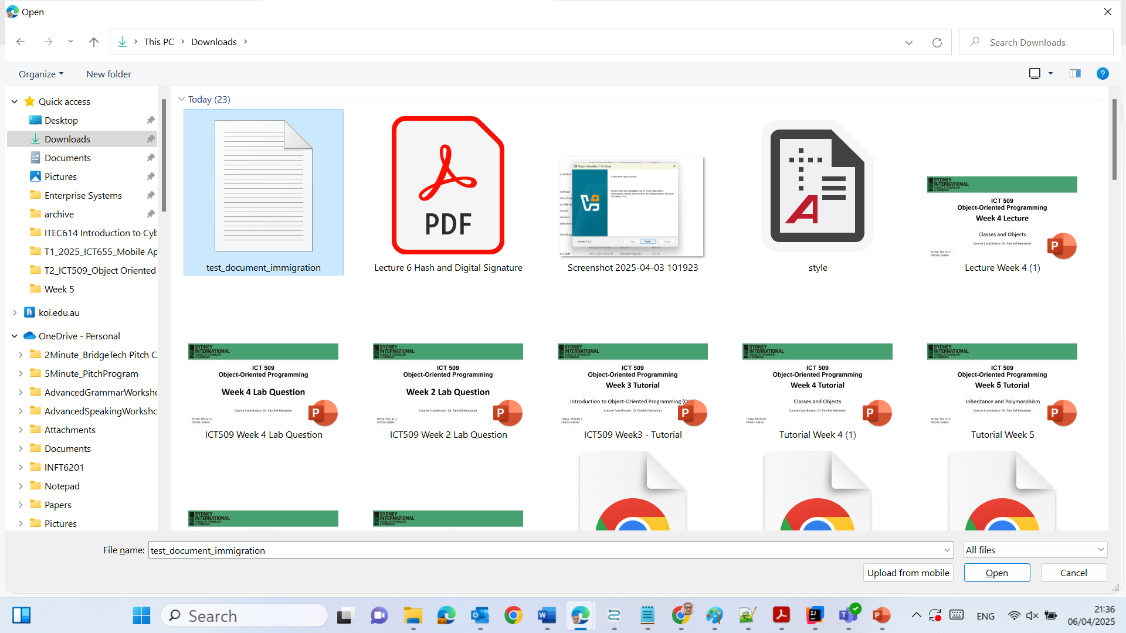
Hands-On Activity
What We Can Include:
1. Integrity Proof
The hash value confirms that this specific message (even a tiny version of it) hasn't been changed. If someone alters the text even slightly, the hash will change completely.

Slide 41
Hands-On Activity
2. Avalanche Effect
Hash functions show high sensitivity — a single character change (like "immigration" → "visa") will produce a completely different hash, proving how hash functions protect data from tampering.

Slide 42
Hands-On Activity
3. Real-World Relevance (Australia-Based Example)
This kind of integrity check is similar to verifying the authenticity of an official Australian immigration document — ensuring what was received is exactly what was sent.

Slide 43
Hands-On Activity
4. Security Implication
SHA-256 provides strong collision resistance — two different messages will not have the same hash. This is why it's trusted for digital signatures and authentication in legal, medical, and government systems.

Slide 44
Hands-On Activity
By using CyberChef’s SHA-256 function on our test document, we simulated how systems like myGov or Australian immigration portals can use hashing to ensure document authenticity and prevent fraud

Slide 45
Australia's Shift from SHA-256: Preparing for a Quantum-Safe Future
While specific details about the internal security implementations of myGov and the Australian Department of Home Affairs are not publicly disclosed, it's common practice for government agencies and organizations handling sensitive information to utilize robust cryptographic methods, such as the SHA-256 hashing algorithm, to ensure data integrity and security.

Slide 46
However, recent developments indicate that Australia plans to phase out certain cryptographic algorithms, including SHA-256, by 2030. This decision is influenced by concerns over advancements in quantum computing, which could potentially compromise current encryption standards. The Australian Signals Directorate (ASD) has outlined that algorithms like SHA-256, RSA, ECDSA, and ECDH will not be approved for use beyond 2030.

Slide 47
Australia's Shift from SHA-256: Preparing for a Quantum-Safe Future
This proactive approach aims to transition to quantum-resistant algorithms to maintain the security of sensitive data in the future. While SHA-256 remains secure and widely used today, organizations are encouraged to stay informed about evolving cryptographic standards and prepare for upcoming transitions to more advanced encryption methods.

Slide 48
Cybersecurity Problem-Solving Question
Scenario: You work in a cybersecurity firm in Sydney. A client is worried their uploaded medical records can be tampered with during transmission.
Question: How can hashing + digital signatures protect their records? Which tools would you suggest?

Slide 49
Answer:
Hashing verifies file integrity (e.g., SHA-256).
Digital signatures ensure authenticity (e.g., private/public key pairs).
Use tools like GPG or OpenSSL to apply hashing + signing.
Recommend uploading via HTTPS and checking hashes on both ends.

Slide 50
Birthday Attack & Collision Resistance
What is a Birthday Attack?
A birthday attack is when someone tries to find two different messages that give the same hash value.

Slide 51
Birthday Attack & Collision Resistance
Why is it called “birthday”?
Because like in a group of people, the chance of two sharing a birthday is higher than you’d expect — same with hash collisions.

Slide 52
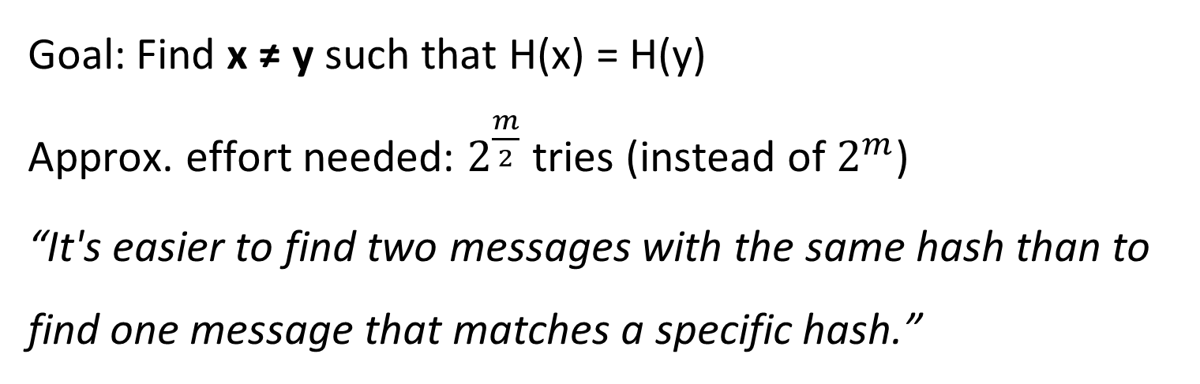
Birthday Attack & Collision Resistance
Goal: Find x ≠ y such that H(x) = H(y)
Approx. effort needed: $2^{\frac{m}{2}}$ tries (instead of $2^{m}$)
“It's easier to find two messages with the same hash than to find one message that matches a specific hash.”

Slide 53
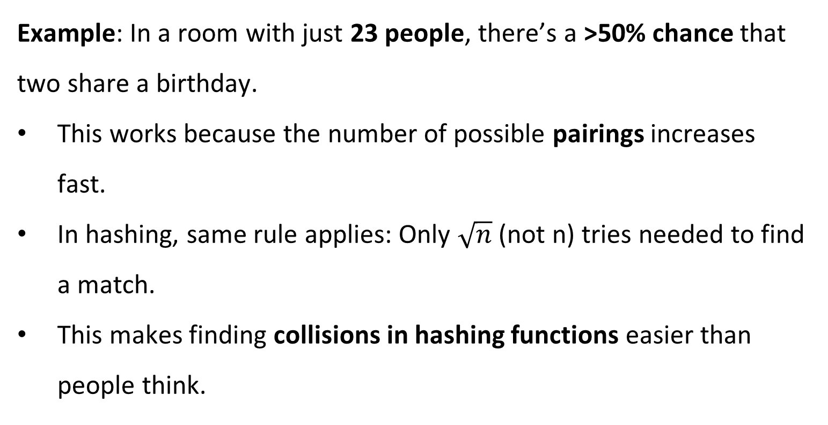
Birthday Problem Made Easy
Example: In a room with just 23 people, there’s a >50% chance that two share a birthday.
This works because the number of possible pairings increases fast.
In hashing, same rule applies: Only $\sqrt{n}$ (not n) tries needed to find a match.
This makes finding collisions in hashing functions easier than people think.

Slide 54
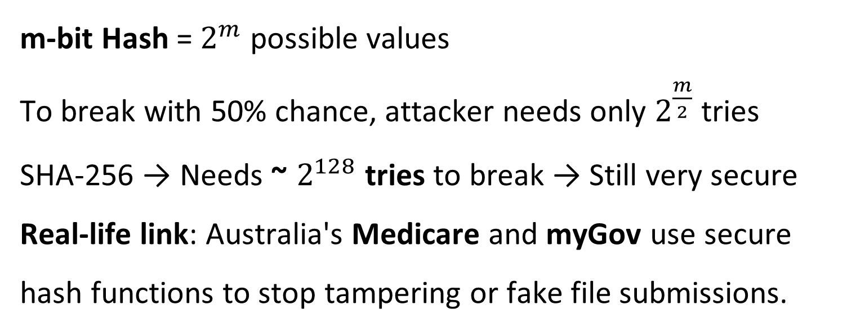
Birthday Math + Hashes
m-bit Hash = $2^{m}$ possible values To break with 50% chance, attacker needs only $2^{\frac{m}{2}}$ tries
SHA-256 → Needs ~ $2^{128}$ tries to break → Still very secure
Real-life link: Australia's Medicare and myGov use secure hash functions to stop tampering or fake file submissions.

Slide 55
Secure Hash Algorithm (SHA) Overview
Developed by NIST & NSA (USA)
SHA-1 (1995) → SHA-2 (2002)
SHA-2 has variants: SHA-256, SHA-384, SHA-512
Common Use:
Digital signatures
e-Health in Medicare
Australian passports and visa documents
Tax records via myGov
SHA = the algorithm, SHS = the US government standard.

Slide 56
Comparison – Preimage vs. Birthday Attack
Attack Type | Goal | Effort Needed | 50% Success Tries | Real-World Example (AU)
Preimage Attack | Find message for known hash | 2^m | 2^(m-1) | Forging a digital signature (e.g., myGov doc)
Birthday Attack | Find 2 messages with same hash | 2^(m/2) | 2^(m/2) | Malware matching safe file's hash

Slide 57
Research Discussion Question
Q: Why is SHA-256 still used today but set to be replaced by 2030 in Australia?
A: Because of the rise of quantum computing, which could break SHA-256 using Grover’s Algorithm. The Australian Signals Directorate (ASD) has announced plans to move toward quantum-resistant algorithms like SPHINCS+, XMSS, etc.

Slide 58
Problem-Solving Task
Scenario:
You're designing a secure file upload system for the Department of Foreign Affairs.
Q: Would you use SHA-1 or SHA-256 for verifying uploaded documents? Why?
Answer: Use SHA-256. SHA-1 is vulnerable to birthday attacks. SHA-256 is currently safe and used by Australian systems like Medicare and myGov.

Slide 59
Cybersecurity Challenge (Real-World Case)
Case:
An attacker uploads a forged visa PDF with the same SHA-1 hash as a real document. It bypasses a naive system.
Q: What type of attack is this? What should the government do?
Response: It’s a collision (birthday) attack. The government should:
Upgrade to SHA-256 or SHA-3
Start planning migration to post-quantum hashing

Slide 60
How Many Tries to Break SHA-1 with a Birthday Attack?
If SHA-1 gives 160-bit hashes, how many trials are needed to break it using a birthday attack?
Effort = 2^(160/2) = 2^80 tries
Not practical today, but might be possible with quantum computers.

Slide 61
Role-Playing Debate
Topic:
“Should Australia phase out SHA-256 now or wait until 2030?”
Team A – Proactive Team
Argue why early migration to quantum-safe algorithms is better
Point to Australia's cyber strategy and potential risks
Team B – Conservative Team
Argue that SHA-256 is still strong
Migration costs are high
Most quantum threats are not immediate

Slide 62
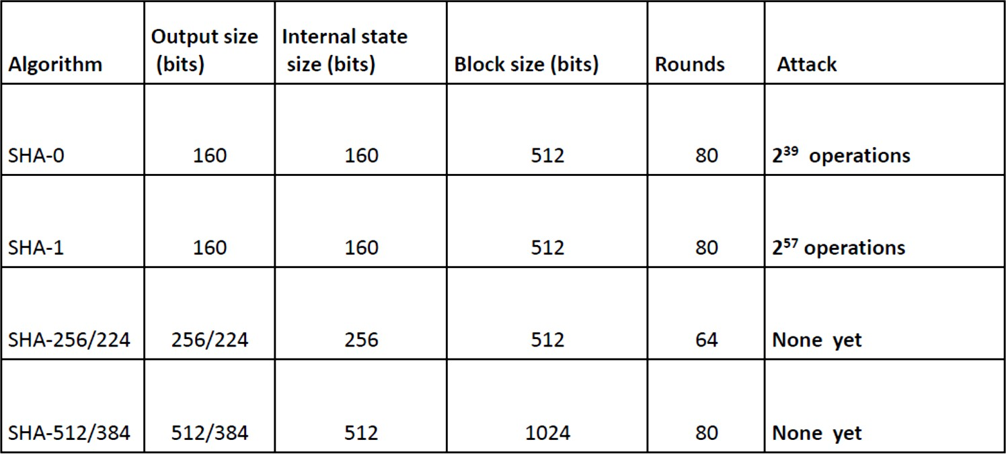
SHA Versions

Slide 63
SHA-3
NIST has announced in 2007 a competition for the
SHA-3, next generation hash function
goal to have in place by 2012
Evaluation criteria
Replace SHA-2 (using same hash size, 512 bits)
Security close to theoretical max for hash sizes (2^{(512/2)} = 2²⁵⁶)
Cost-effective in time & memory (efficient)
Characteristics: such as flexibility & simplicity

Slide 64
Digital Signature

Slide 65
What Is a Digital Signature?
Key Idea: Like a handwritten signature, but for digital documents.
Simple Summary:
Proves who sent a message.
Shows when it was sent (timestamp).
Verifies nothing was changed.
Example: A digital tax return via myGov uses a digital signature to verify your submission.

Slide 66
How Does It Work? (DS Model)
Steps:
Bob (sender) makes a hash of the message.
He signs it using his private key.
Alice (receiver) checks the hash using Bob’s public key.
If the hash matches, it’s authentic!
Analogy: It's like sealing a letter with your fingerprint – only your fingerprint can make that seal.

Slide 67
Key Properties of Digital Signatures
Must be tied to the message.
Unique to the sender (uses their private key).
Fast to make and check.
Very hard to fake (unless quantum computers break it).
Real-World Link: In Australia, platforms like Medicare and myGovID use these principles for secure communication.

Slide 68
ElGamal Digital Signature – Introduction
Invented by Taher ElGamal in 1984.
Based on discrete logarithm problem – very hard to reverse.
Uses a random secret key (xA) to create a public key (yA).
Used in: early versions of PGP (Pretty Good Privacy).

Slide 69
ElGamal Signature Steps
To Sign:
Hash the message.
Pick a random number K.
Do some modular maths to get two values: S₁, S₂.
These form the signature: (S₁, S₂).

Slide 70
ElGamal Signature Steps
To Verify:
Receiver does more modular math using sender’s public key.
If V₁ = V₂, the signature is valid.
Think of it like a secure stamp + code check.

Slide 71
Example – ElGamal in Action
Given Values:
Prime modulus: q = 19
Generator: a = 10
Private key: xA = 16
Hash of message: m = 14
Random integer: K = 5
Signature: (S₁ = 3, S₂ = 4)

Slide 72
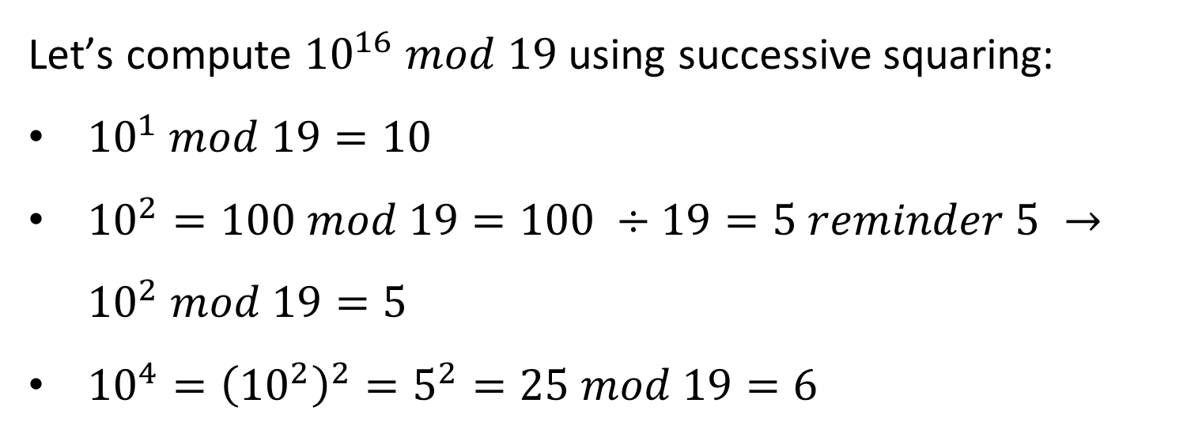

Example – ElGamal in Action
Compute Public Key
$$y_{A}=a^{x_{A}} mod q={10}^{16} mod 19$$
Let’s compute ${10}^{16} mod 19$ using successive squaring:
${10}^{1} mod 19=10$
${10}^{2}=100 mod 19=100 ÷19=5 reminder 5 →{10}^{2} mod 19=5$
${10}^{4}={\left({10}^{2}\right)}^{2}=5^{2}=25 mod 19=6$

Slide 73
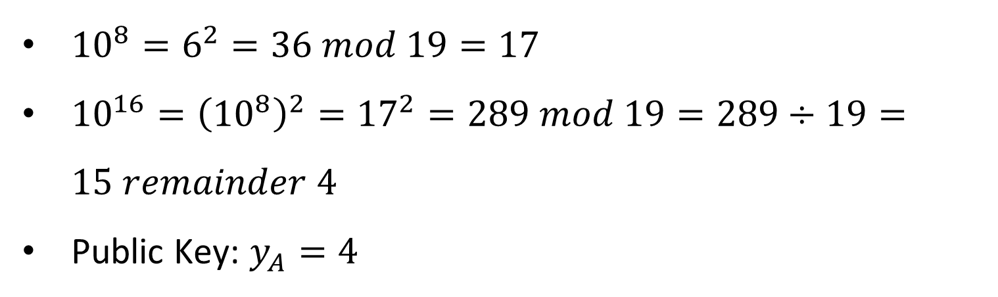
Example – ElGamal in Action
${10}^{8}=6^{2}=36 mod 19=17$
${10}^{16}={\left({10}^{8}\right)}^{2}={17}^{2}=289 mod 19=289÷19=15 remainder 4$
Public Key: $y_{A}=4$

Slide 74
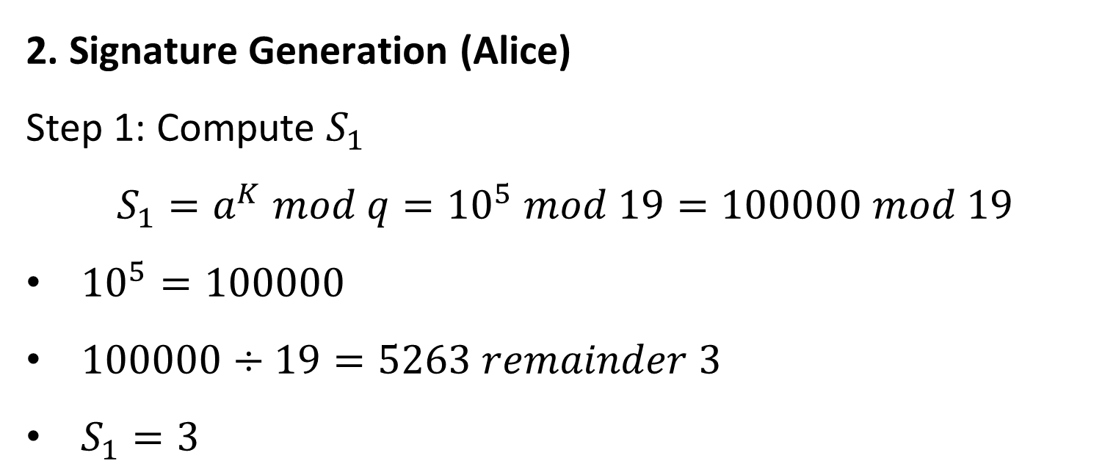
Example – ElGamal in Action
2. Signature Generation (Alice)
Step 1: Compute $S_{1}$
$$S_{1}=a^{K} mod q={10}^{5} mod 19=100000 mod 19$$
${10}^{5}=100000$
$100000÷19=5263 remainder 3$
$S_{1}=3$

Slide 75
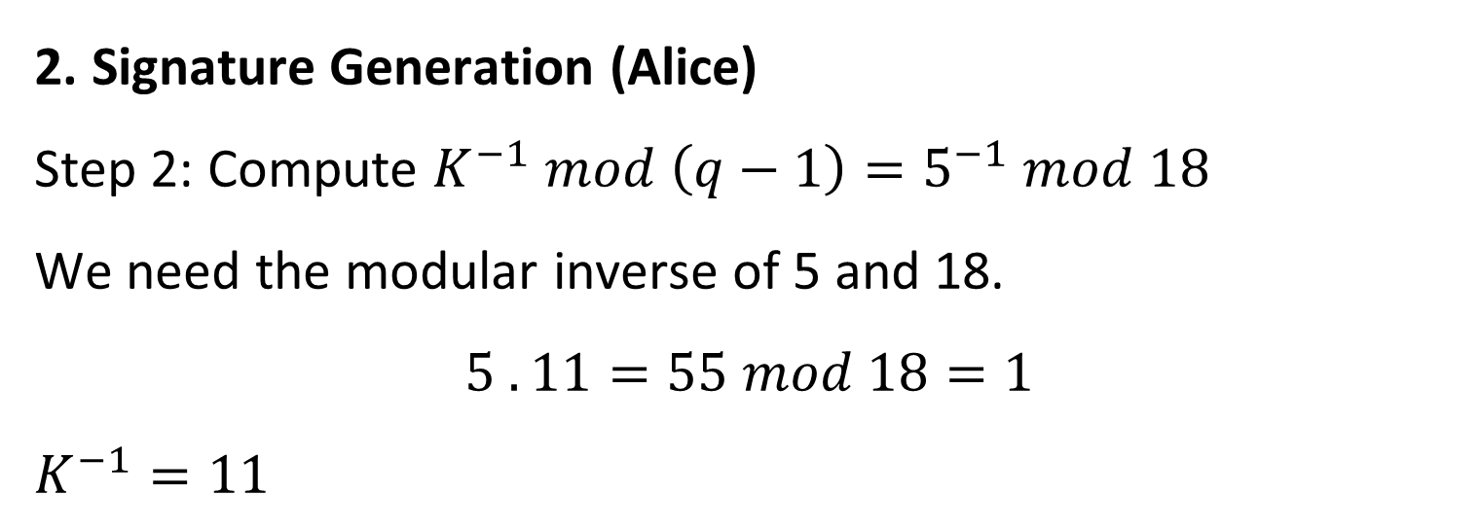
Example – ElGamal in Action
2. Signature Generation (Alice)
Step 2: Compute $K^{−1} mod \left(q−1\right)=5^{−1} mod 18$
We need the modular inverse of 5 and 18.
$$5 . 11=55 mod 18=1$$
$K^{−1}=11$

Slide 76
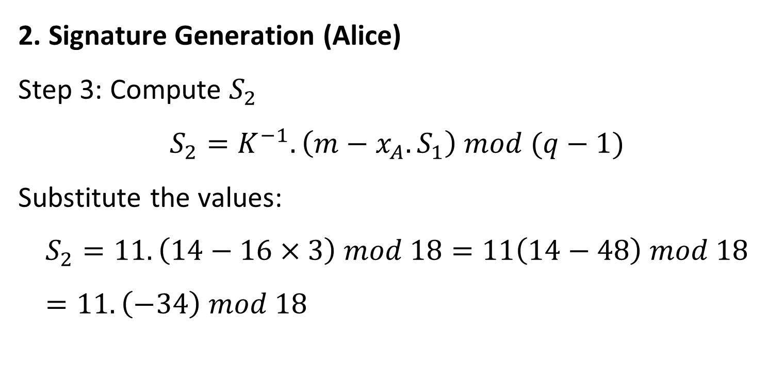
Example – ElGamal in Action
2. Signature Generation (Alice)
Step 3: Compute $S_{2}$
$$S_{2}=K^{−1}.\left(m−x_{A}.S_{1}\right) mod (q−1)$$
Substitute the values:
$$S_{2}=11.\left(14−16×3\right) mod 18=11\left(14−48\right) mod 18=11.\left(−34\right) mod 18$$

Slide 77
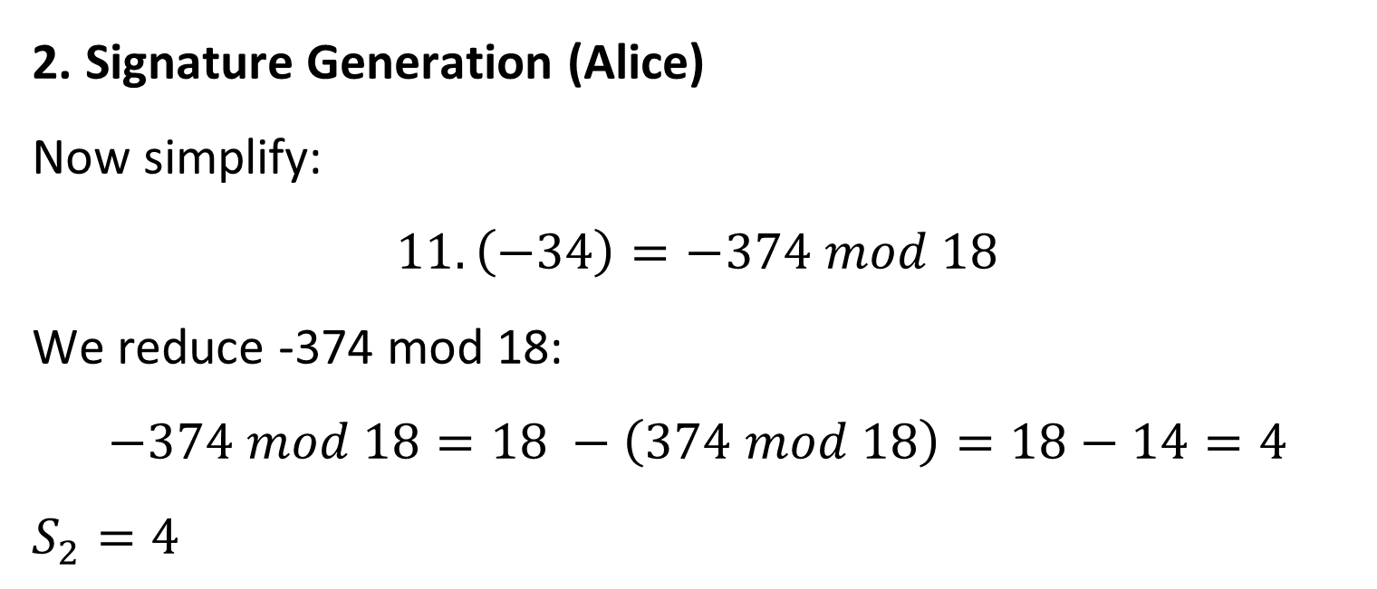
Example – ElGamal in Action
2. Signature Generation (Alice)
Now simplify:
$$11.\left(−34\right)=−374 mod 18$$
We reduce -374 mod 18:
$$−374 mod 18=18 −\left(374 mod 18\right)=18−14=4$$
$S_{2}=4$

Slide 78
Example – ElGamal in Action
So the final signature is:
Signature: (S1,S2) = (3,4)

Slide 79
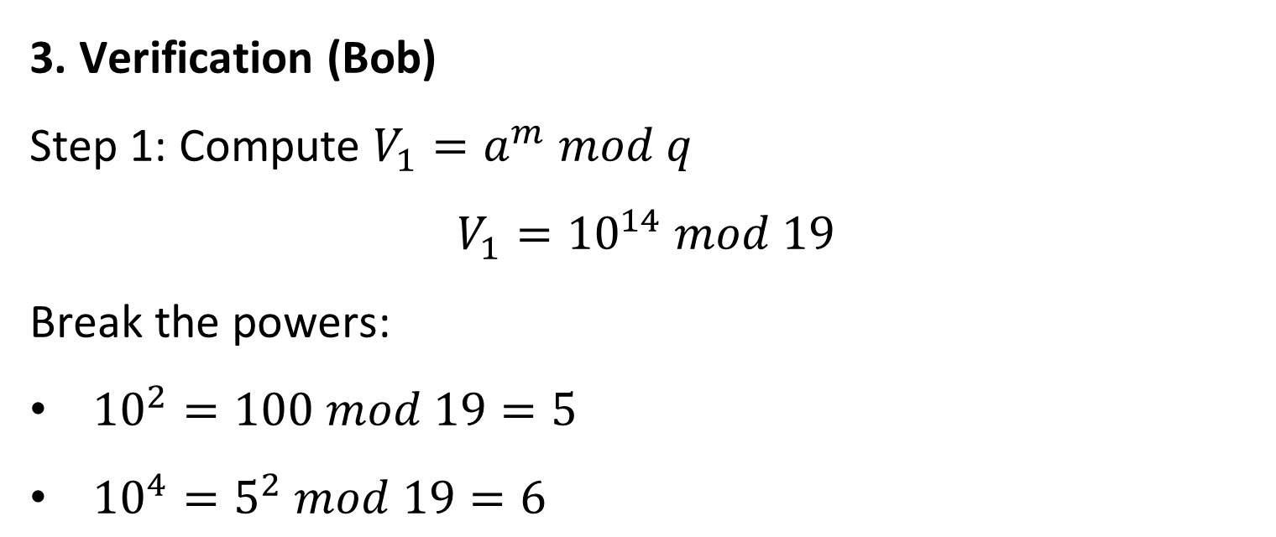
Example – ElGamal in Action
3. Verification (Bob)
Step 1: Compute $V_{1}=a^{m} mod q$
$$V_{1}={10}^{14} mod 19$$
Break the powers:
${10}^{2}=100 mod 19=5$
${10}^{4}=5^{2} mod 19=6$

Slide 80
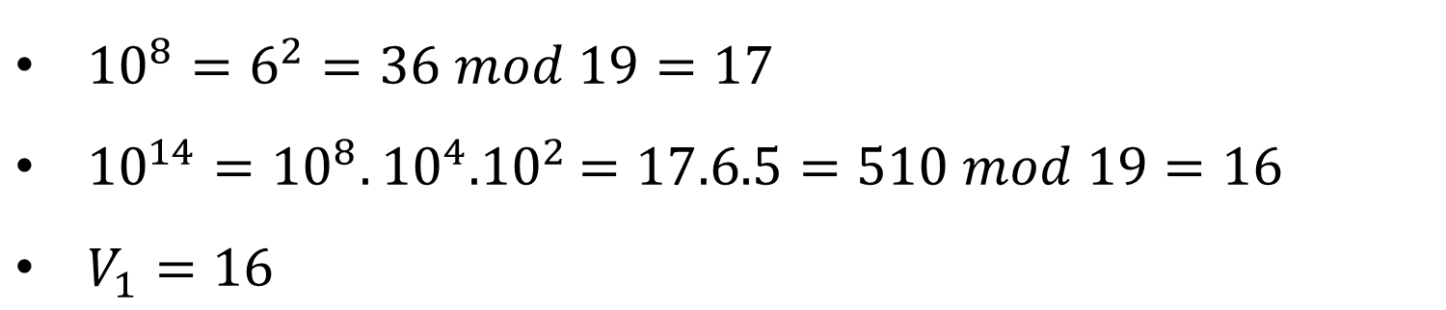
Example – ElGamal in Action
${10}^{8}=6^{2}=36 mod 19=17$
${10}^{14}={10}^{8}.{10}^{4}{.10}^{2}=17.6.5=510 mod 19=16$
$V_{1}=16$

Slide 81
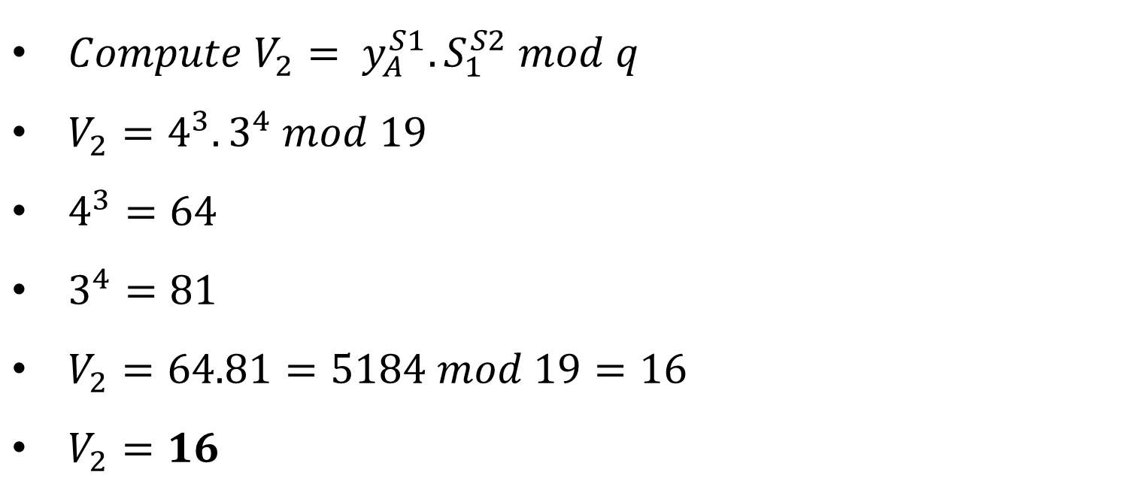
Example – ElGamal in Action
$Compute V_{2}= y_{A}^{S1}.S_{1}^{S2} mod q$
$V_{2}=4^{3}.3^{4} mod 19$
$4^{3}=64$
$3^{4}=81$
$V_{2}=64.81=5184 mod 19=16$
$V_{2}=16$

Slide 82
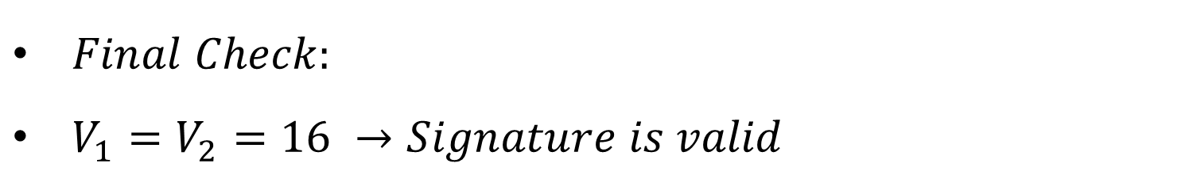
Example – ElGamal in Action
$Final Check:$
$V_{1}=V_{2}=16 →Signature is valid$

Slide 83
DSS – Digital Signature Standard
Introduced by US Gov in 1991.
Core algorithm = DSA (Digital Signature Algorithm) → A version of ElGamal.
Uses SHA-based hashing.
Australia’s secure email gateways, like those in gov.au domains, rely on DSS/DSA-backed encryption.

Slide 84
Comparison Table: ElGamal vs DSS vs RSA
Feature | ElGamal | DSS | RSA (for signatures)
Based On | Discrete logarithms | Variant of ElGamal | Integer factorization
Hash Function | Separate (like SHA) | SHA-based | Usually SHA-based
Common in | PGP, Research | Government Standards | Browsers, Certificates

Slide 85
Comparison Table: ElGamal vs DSS vs RSA
Feature | ElGamal | DSS | RSA (for signatures)
Quantum Secure? | X | X | X
Still Used in AUS? | Some legacy systems | Yes, in secured gov. docs | Yes, in certificates

Slide 86
Research Discussion Questions
Q1: Why do we use both hashing and encryption in digital signatures?
A: Hashing ensures message integrity, encryption confirms authenticity. Together, they prove "who said what".

Slide 87
Research Discussion Questions
Q2: Why is randomness (like ‘K’ in ElGamal) essential in digital signatures?
A: Without randomness, signatures could be reused, allowing attackers to copy and fake them.

Slide 88
Research Discussion Questions
Q3: How might post-quantum cryptography change how digital signatures work in Australia?
A: We’ll need new algorithms like SPHINCS+ to stay secure when quantum computers emerge.

Slide 89
Hands-On Activity
Task: Use OpenSSL or CrypTool to simulate a digital signature.
Create a message: “Visa approval for subclass 600”
Hash it using SHA-256.
Encrypt the hash using your private key (simulate signing).
Verify using your public key.
Follow-up: Try the same process using a different message. See how the signature changes.

Slide 90
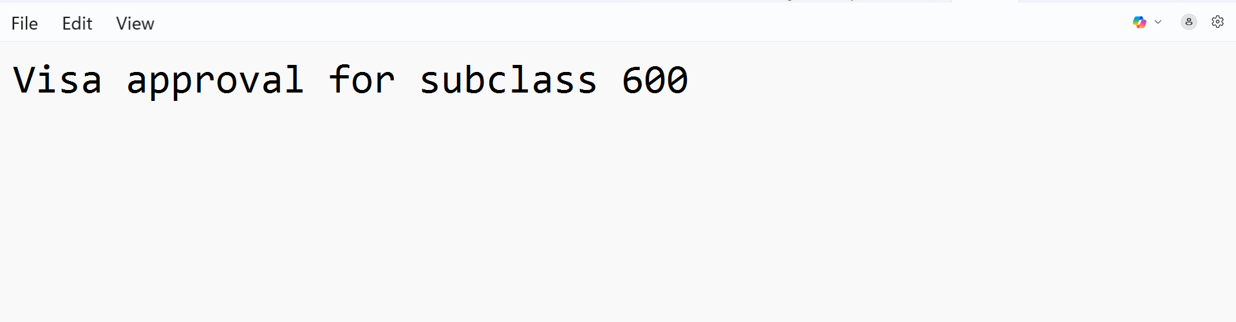
Hands-On Activity
1. Open Notepad, type:
Visa approval for subclass 600
Then save it as visa_message.txt

Slide 91

Hands-On Activity
2. Open visa_message.txt
In CrypTool

Slide 92
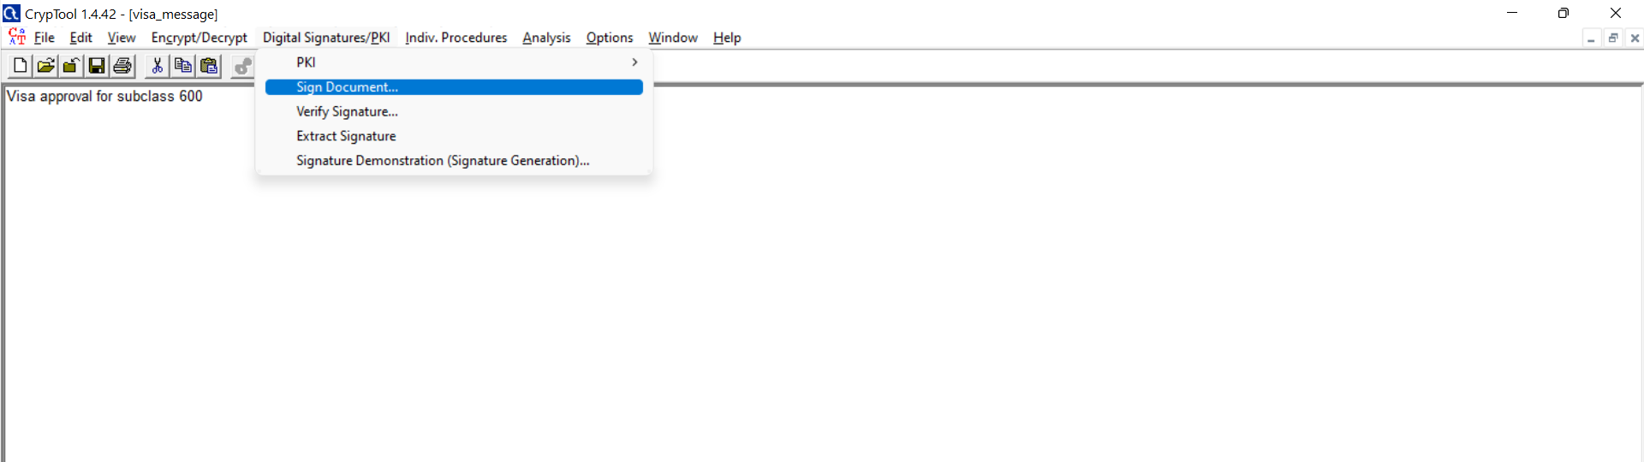
Hands-On Activity
3. Go to Digital Signatures/PKI → Sign Document...

Slide 93
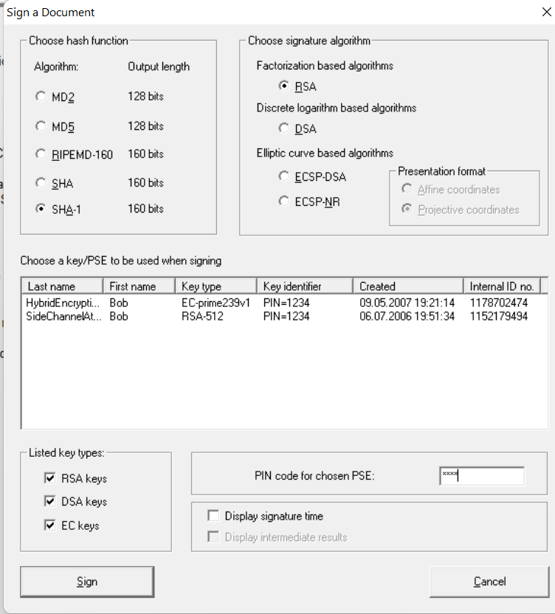
Hands-On Activity
4. Choose the Hash Function
From the left panel, choose a hash function. Select: SHA-1
5. Select the Signature Algorithm
From the right panel, select: RSA.

Slide 94
Hands-On Activity
6. Select a Key
There are two keys listed, click on SideChannelAttacks... with RSA-512
7. Enter the PIN
Try typing 1234 in the PIN field.
8. Click ‘Sign”

Slide 95
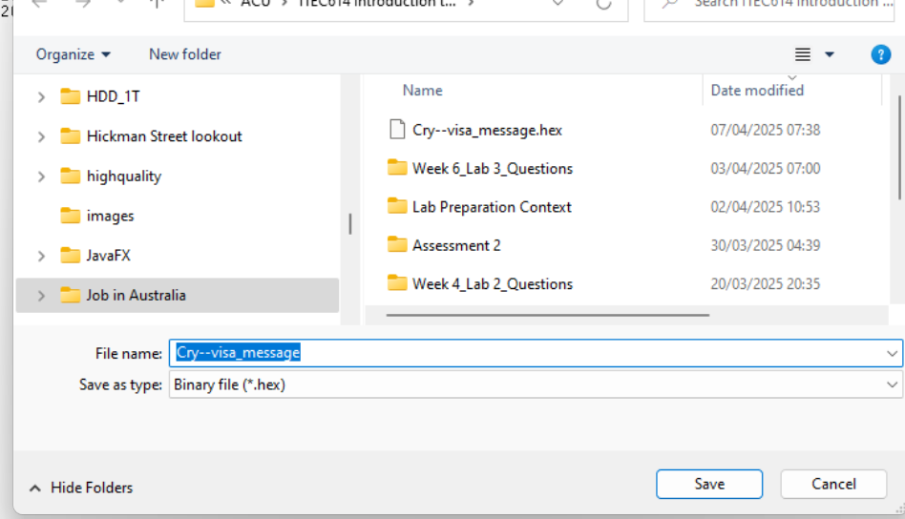
Hands-On Activity
9. Save it
Now your file is digitally signed using:
SHA-1 as hash
RSA with our private key
We’ve simulated signing.

Slide 96
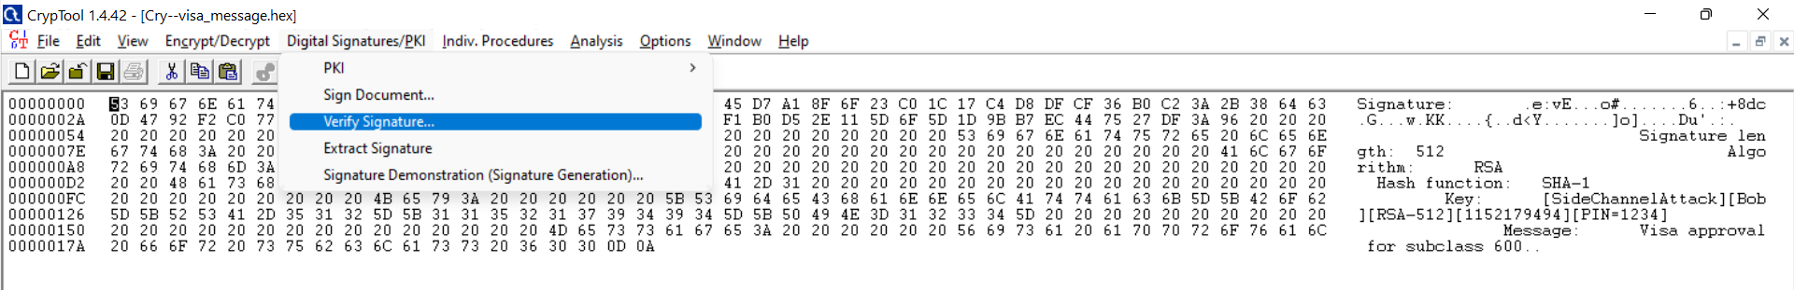
Hands-On Activity
10. Verify the Signature
Go to: Digital Signatures/PKI → Verify Signature...

Slide 97
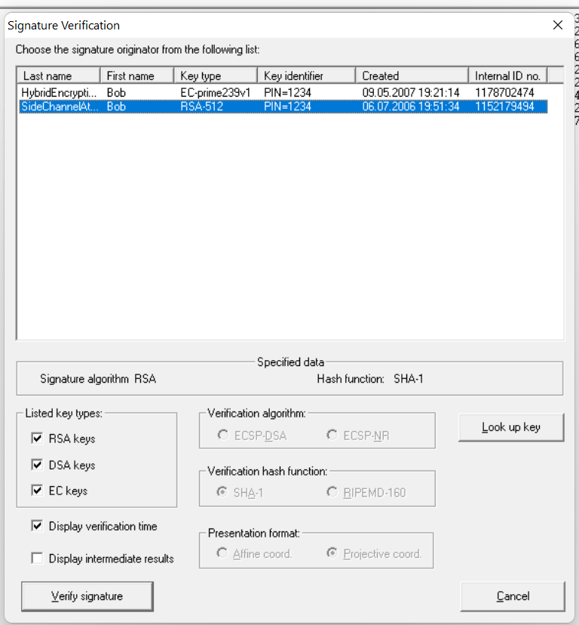
Hands-On Activity
When the dialog opens:
Select the correct key
In the Signature Verification window:
You already see two keys.
Click on: SideChannelAttack | Bob | RSA-512
This matches the key we used earlier to sign the message
Click on Verify Signature

Slide 98
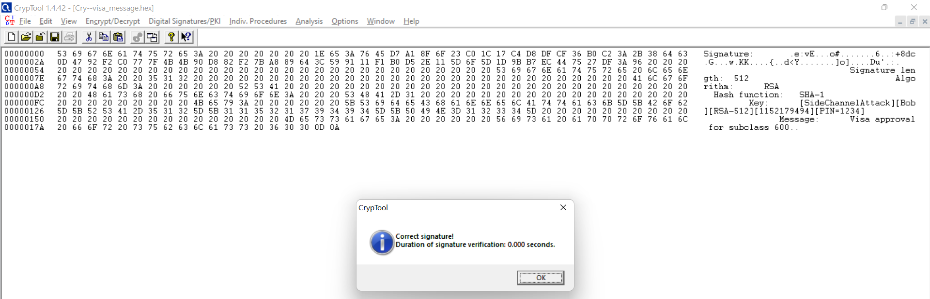
"Correct signature! Duration of signature verification: 0.000 seconds."
This confirms that:
Your message (Visa approval for subclass 600) was successfully signed using your private RSA key.

Slide 99
The hash (SHA-1) from our original message matches the decrypted signature.
The public key verification was successful — meaning no tampering occurred and authenticity is confirmed.

Slide 100
Cybersecurity Problem
Scenario: A fake website issues forged digital tax receipts with someone else’s ABN.
Q: What cryptographic weakness is being exploited?
A: Signature spoofing — if they fake or reuse digital signatures.
Solution: Use updated signature schemes (e.g., DSS with SHA-256) and enforce certificate validation.

Slide 101
Digital Signature Spoofing: Cryptographic Weakness and Solution
Scenario: A fake website issues forged digital tax receipts with someone else’s ABN.
Q: What cryptographic weakness is being exploited?
A: Signature spoofing — if they fake or reuse digital signatures.
Solution: Use updated signature schemes (e.g., DSS with SHA-256) and enforce certificate validation.

Slide 102
Role-Playing Debate
Topic: "Should Australia immediately move away from SHA-256 to quantum-safe digital signature algorithms?"
Teams:
For: Prioritize national security, prepare early.
Against: Expensive, not practical yet, SHA-256 is still secure.

Slide 103
Next Week
We will study
Web Security

Slide 104

Questions?

Slide 105
Thank You
Have a Great Learning Day!
Feel free to reach out with any questions!
Dr. Farshid Keivanian

